Slide 1

Calculation of
Macronutrient Percents
(Fat, Carbs, Protein)
For a Meal
July 2025

Slide 2
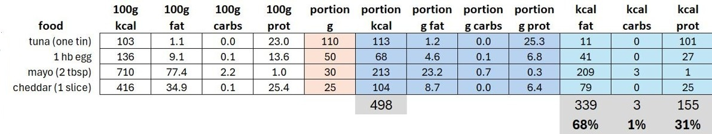
We are going to build this table
- Not so daunting
- All the colored cells (except portion) are calculated
- I can make the Excel template available
“In this meal, 68% of the calories come from fat.”
FOOD

Slide 3
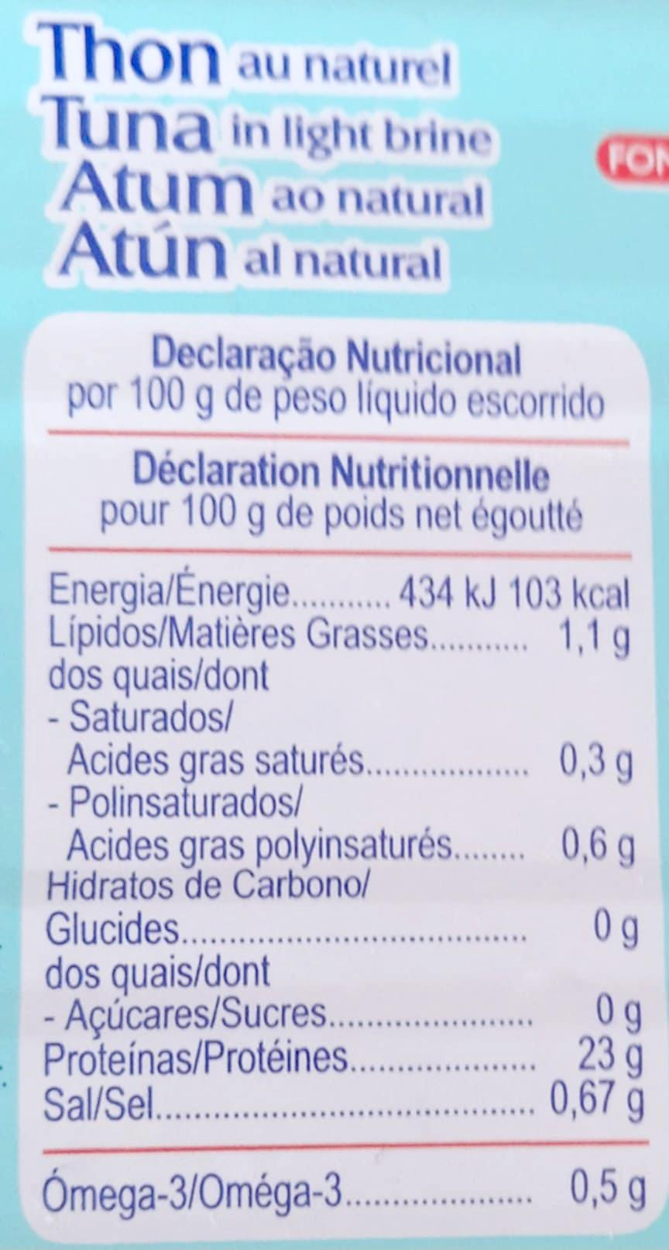

The numbers come from the nutrition label,
or from internet lookup

Slide 4
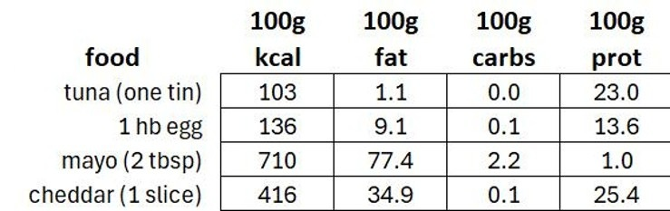
Lookup:
"macros 100g medium egg"

Slide 5
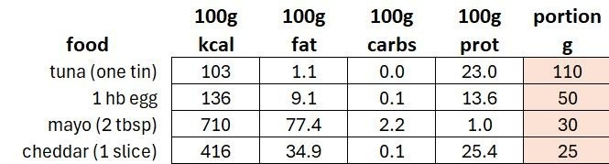
Now we add portion size (in grams):
The tuna is 110g (stated on tin)
A medium egg is about 50g (internet lookup)
Mayo: a tbsp is about 15g
Cheddar: 10 slices in a 250g package

Slide 6
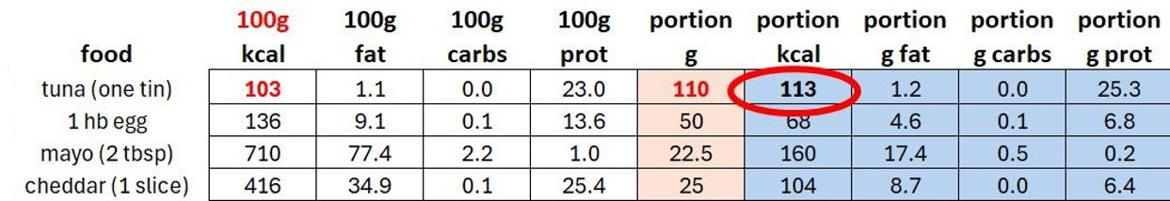
Now we calculate the portion numbers (in blue)
For example, if there are 103 kcal in 100g of tuna,
how many kcal are there in our portion size of 110g?
= ( 103 X 110 ) / 100

Slide 7
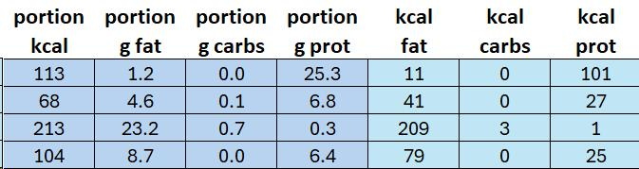
Now we calculate the kcals per the portion grams:
There are 9 kcal per gram of fat: 11 = 1.2 X 9 (why fat is satiating)
There are 4 kcal per gram of carb and per gram of protein: 101= 25.3 X 4

Slide 8
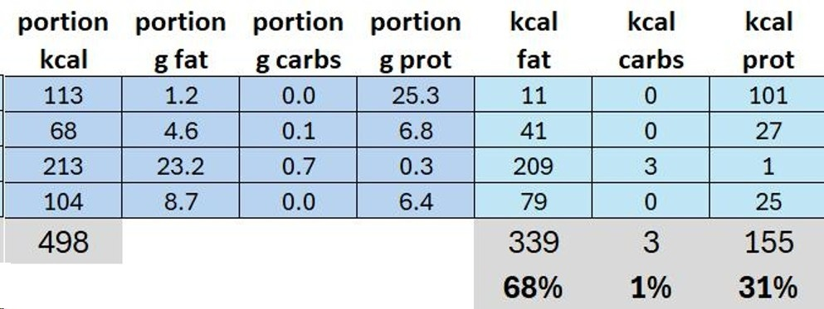
Now add totals and percents:
339 / 498 = 68%

Slide 9
Now, let’s discuss the final table:

Slide 10
End.
Thank you so much for attending.
More to come, if you wish.
July 2025

